Slide 1


X1 | X2 | X3 | X4
Notes:
agencies

Slide 2
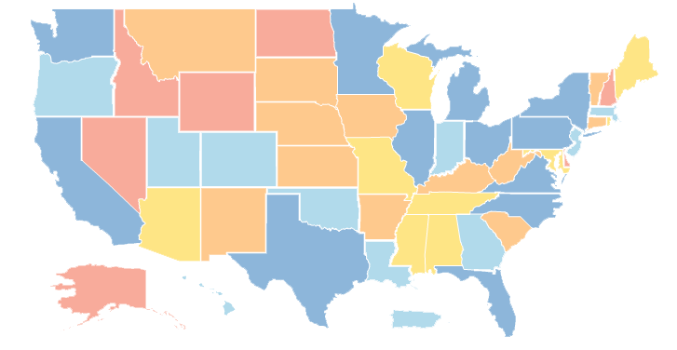
X1 | X2 | X3 | X4
Notes:
sites

Slide 3

JAN
FEB
MAR
APR
MAY
X1 | X2 | X3 | X4
Notes:
time

Slide 4

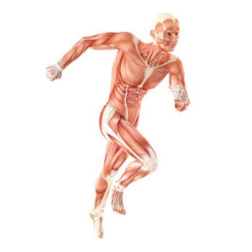

X1 | X2 | X3 | X4
Notes:
instruments

Slide 5
X1 | X2 | X3 | X4
X1 | X2 | X3 | X4
X1 | X2 | X3 | X4
X1 | X2 | X3 | X4
Notes:
datasets

Slide 6
Data Frame One
Var1 | Var2 | Var3
1
2
3
4
Data Frame Two
Var1 | Var2 | Var3
5
6
7
8
Notes:
two_data_sets1

Slide 7
Data Frame One
Var1 | Var2 | Var3
1
2
3
4
Var1 | Var2 | Var3
1
2
3
4
5
6
7
8
Data Frame Two
Var1 | Var2 | Var3
5
6
7
8
Notes:
two_data_sets2

Slide 8
Trial
Year | N | Outcome
2016 | 501 | 51
2017 | 499 | 52
2018 | 498 | 49
2019 | 502 | 50
Trial_2020
Year | N | Outcome
2020 | 500 | 48
Notes:
trial

Slide 9
Data Frame One
Data Frame Two
Var1 | Var2 | Var3
1
2
3
4
Var1 | Var4 | Var5
1
2
3
4
Notes:
two_data_Frames_horiz

Slide 10
Data Frame Combined
Data Frame One
Data Frame Two
Var1 | Var2 | Var3 | Var4 | Var5
1
2
3
4
Var1 | Var2 | Var3
1
2
3
4
Var1 | Var4 | Var5
1
2
3
4
Notes:
goal

Slide 11
Combine Horizontally
Match By Position
Match By Key Value(s)
Merge
(Mutating Join)
bind_col()
left_join()
right_join()
full_join()
inner_join()
Notes:
flow_chart

Slide 12
Match By Position
Data Frame One
Data Frame Two
Data Frame Two
Var1 | Var2 | Var3
Var4 | Var5 | Var6
Row 1
Row 2
Row 3
Row 4
Notes:
position

Slide 13
Combine Horizontally
Match By Position
Match By Key Value(s)
Merge
(Mutating Join)
bind_col()
left_join()
right_join()
full_join()
inner_join()
Notes:
flow_chart_key_value

Slide 14
One-to-One
Data Frame One
Data Frame Two
Data Frame Two
Var1 | Var2 | Var3
1
2
3
4
Var1 | Var4 | Var5
2
1
3
4
Notes:
one_to_one

Slide 15
One-to-Many
Data Frame Two
Var1 | Var4 | Var5
1
1
2
2
3
3
4
4
Data Frame One
Var1 | Var2 | Var3
1
2
3
4
Notes:
one_to_many

Slide 16
Many-to-Many
Data Frame One
Data Frame Two
Var1 | Var2 | Var3
1
1
2
2
3
3
4
4
Var1 | Var4 | Var5
1
1
2
2
3
3
4
4
Notes:
many_to_many

Slide 17
x Data Frame
left_join()
y Data Frame
Var1 | Var2 | Var3
1
2
3
4
6
Var1 | Var4 | Var5
2
1
3
4
5
Result
Var1 | Var2 | Var3 | Var4 | Var5
1
2
3
4
6 |  |  | NA | NA
Notes:
left_join

Slide 18
x Data Frame
right_join()
y Data Frame
Var1 | Var2 | Var3
1
2
3
4
6
Var1 | Var4 | Var5
2
1
3
4
5
Result
Var1 | Var2 | Var3 | Var4 | Var5
1
2
3
4
5 | NA | NA
Notes:
right_join

Slide 19
x Data Frame
full_join()
y Data Frame
Var1 | Var2 | Var3
1
2
3
4
6
Var1 | Var4 | Var5
2
1
3
4
5
Result
Var1 | Var2 | Var3 | Var4 | Var5
1
2
3
4
5 | NA | NA
6 |  |  | NA | NA
Notes:
full_join

Slide 20
x Data Frame
inner_join()
y Data Frame
Var1 | Var2 | Var3
1
2
3
4
6
Var1 | Var4 | Var5
2
1
3
4
5
Result
Var1 | Var2 | Var3 | Var4 | Var5
1
2
3
4
Notes:
inner_join

Slide 21
Many-to-Many
demographics/grip_strength
emr
id | visit | dob | race_eth | grip_r | grip_l
1001 | pre
1001 | post
1002 | pre
1002 | post
1003 | pre
1003 | post
1004 | pre
1004 | post
id | visit | weight
1001 | pre
1001 | post
1002 | pre
1002 | post
1003 | pre
1003 | post
1004 | pre
1004 | post
Notes:
many_to_many_emr

Slide 22
One-to-One
demographics/grip_strength
emr
id | visit | dob | race_eth | grip_r | grip_l
1001 | pre
1001 | post
1002 | pre
1002 | post
1003 | pre
1003 | post
1004 | pre
1004 | post
id | visit | weight
1001 | pre
1001 | post
1002 | pre
1002 | post
1003 | pre
1003 | post
1004 | pre
1004 | post
Notes:
one_to_one_emr

